Slide 1
Traffic Sign Classification
Mini Project -II
Presented By- Uttam Singh, Prateek Rai

Slide 2
Table of contents
01
02
03
04
Introduction
Use
Functional Specification
Future Scope

Slide 3
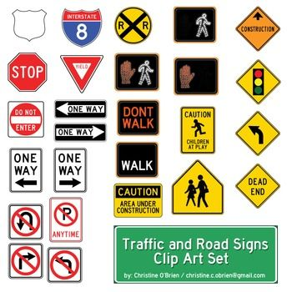
Introduction
This thesis presents a system to recognise and classify road and traffic signs for the purpose of developing an inventory of them which could assist the highway engineers’ tasks of updating and maintaining them. It uses images taken by a camera from a moving vehicle. The system is based on three major stages:
colour segmentation
Recognition
classification.

Slide 4
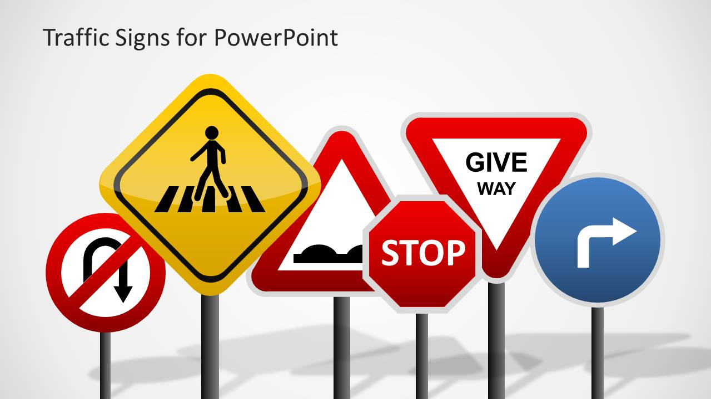
Use of Traffic Sign Classification
Traffic sign classification is the process of automatically recognizing traffic signs along the road, including speed limit signs, yield signs, merge signs, etc. Being able to automatically recognize traffic signs enables us to build “smarter cars”.
Self-driving cars need traffic sign recognition in order to properly parse and understand the roadway. Similarly, “driver alert” systems inside cars need to understand the roadway around them to help aid and protect drivers.

Slide 5
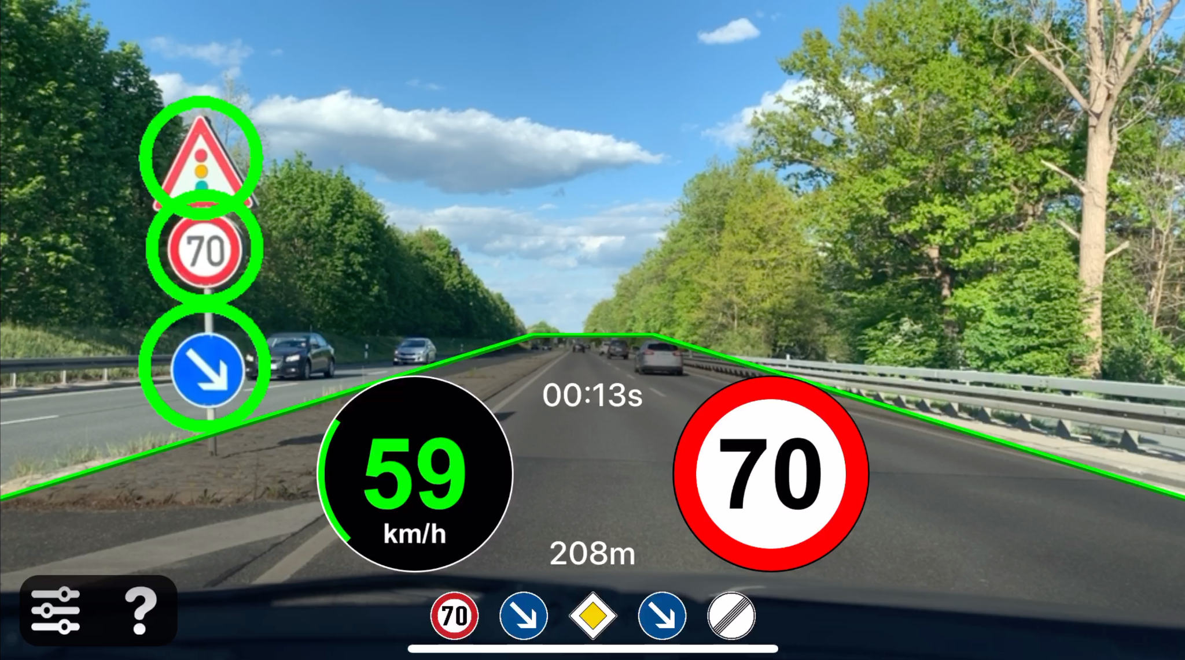
Functional Specification
The application of processing algorithms shall take the pre-processed image and find colours of interest and look for shapes relating to the sign or signs we are searching for.
This block shall find regions of interest on the image and these will be further processed to obtain the type of sign. This is done in the following block.
The classify sign block shall take the regions of interest passed from the algorithms block. These regions will be analysed and used to compare to ‘templates’ of known signs.
This allows for the system to identify exactly what sign is contained in the image that was processed.
The highlight image subsystem shall create some sort of distinguishing box or highlight around the actual sign.

Slide 6
Requirements
Software Requirements
Hardware requirement
Technology Implemented : Deep Learning(CNN, pandas,
matplotlib, keras)
Language Used : Python
Development Environment : Pycharm
Interface : GUI
Processor : Intel core i5s/RYZEN 3
Operating System : Windows 10
RAM : 4+ GB
Hard Disk : 64 GB
Hardware Devices : Computer System

Slide 7
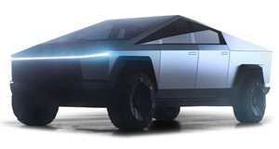
Future Scope
The main problem with these occlusions is that these signs are unpredictable and the shapes produced by them are also unpredictable. A number of researchers have already started to tackle this problem seriously, but the amount of work is still below what is necessary.
Another direction for further research is to develop a real time traffic sign recognition system which captures a video by a camera mounted on the vehicle, detects and recognises the traffic signs in real time and gives the result to the driver within a sufficient time frame in order to take the right action.

Slide 8
Thank You

